Slide 1
Computer Organization Assembly Programming
CSE 230 Computer Organization Assembly Programming
Administrative Rules
Course Syllabus and Outline
Computer Systems Revision and new concepts
© Gamal Fahmy

Slide 2

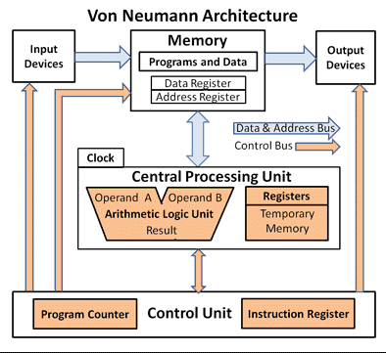


What is CSE 230
It is a Sophomore level course that provides a comprehensive understanding of Computer Organization and Architecture basic topics in Computer Systems
Perquisite CSE 232
© Gamal Fahmy

Slide 3


Why CSE230
For Computer majors it is very essential and crucial in understanding all Hardware and Software related topics.
For Engineering and Science majors it is very essential in understanding the operational behavior in any MACHINE
To understand how to build a Computer.
How to design and debug a Computer system.
How to use Computers in other applications
© Gamal Fahmy

Slide 4

Objectives
Understand Basic Concept of a Finite State Machine
Understand Basic Concept of a Computer.
Understand Design concept of Microprocessor
Describe the Basics of Assembly Language
Understand Design concepts of Memory and I/O Peripherals
Understand Design Concept of Instruction set architecture
Understand Computer Architectural topics like pipelining, Memory Hierarchy and Hazards.
© Gamal Fahmy

Slide 5
Syllabus
Check the course outline
Instructor: Dr. Gamal Fahmy
Instructor Office Hours: Monday, 12:00 pm to 3:00 pm in AO.I.256
Reference Book, Hennessey and Patterson, Introduction to Computer Architecture
“To book time for office hours please send an email to Gamal.Fahmy@gu.edu.eg and expect a confirmation”.
Weekly Assignments shall be handed-in before deadline; no late assignments will be accepted. It is due EVERY week before tutorial.
There will be NO makeup examinations for students not attending the Quizzes, Mid Term and Final Examination, except with admin excuse.
No marks will be given to students attending the examinations in a different time other than their assigned examination time.
© Gamal Fahmy

Slide 6
Grading Criteria
Quizzes | 10
Tutorial Assignments | 10
Mid Term Examination | 10
Final Examination | 40
Project | 30
Total | 100
© Gamal Fahmy

Slide 7

Reminders
Visit the class web site regularly
It will be posted electronically
Don’t postpone your work
Cheating will not be tolerated
Keep in touch with Instructor and TA’s
© Gamal Fahmy

Slide 8
Revision (State Machine)
State Machine
Finite State Machine (Mealy)
    Mealy FSM
Finite State Machine (Moore)
    Moore FSM

Slide 9
State Machine
Any device that has memory and a control/clock input is called a sequential machine. Latches, flip-flops, and ripple counters are examples of sequential machines.
When devices are synchronized so that all of their states change in synchronism with a clock pulse, we call them synchronous sequential machines or simply synchronous machines.

Slide 10
State Machine
To design synchronous machines, we’ll need four tools:
  Karnaugh Map
  State Definition Table - A table listing all states, what they mean in plain English, and the binary value assigned to each state. (Toughest)

Slide 11
State Machine
  State Diagram - a directed graph with nodes representing states, arrows representing valid state transitions and annotations (on arrows) indicating the input conditions causing these transitions.
State
[Output]
Input(s)
X₁,X₂
  Transition Table - A listing of all possible state and input combinations, and the corresponding state transitions.

Slide 12
Analysis of Sequential Circuits
J
Clk
K
Q
Q
A
JK
Flip Flop
x
J
Clk
K
Q
Q
B
JK
Flip Flop
CLK

Slide 13
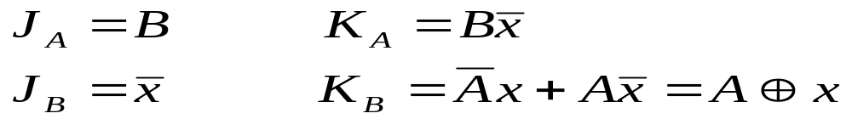
Analysis of Sequential Circuits
Present State |  | Input | Next State |  | Flip Flop Inputs
A | B | x | A | B | JA KA | JB KB
0 | 0 | 0 | 0 | 1 | 0 0 | 0
0 | 0 | 1 | 0 | 0 | 0 0 | 0 1
0 | 1 | 0 | 1 | 1 | 1 | 0
0 | 1 | 1 | 1 | 0 | 0 | 0 1
1 | 0 | 0 | 1 | 1 | 0 0 | 1
1 | 0 | 1 | 1 | 0 | 0 0 | 0 0
1 | 1 | 0 | 0 | 0 | 1 | 1
1 | 1 | 1 | 1 | 1 | 0 | 0 0

Slide 14
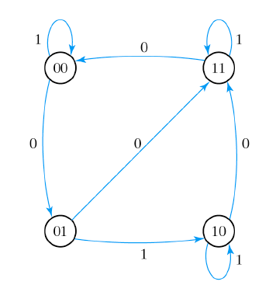
Analysis of Sequential Circuits

Slide 15
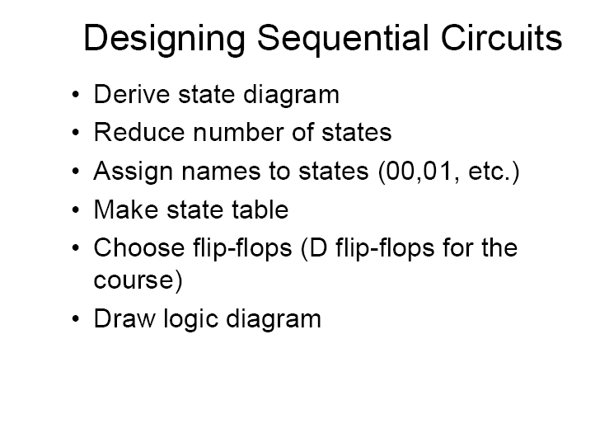
Design of State Machine
Slide Taken from Dr Kareem Darwish

Slide 16
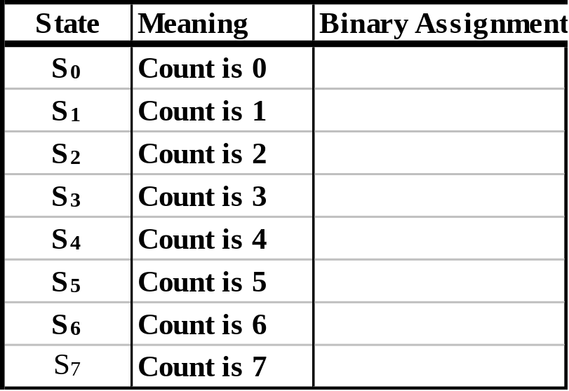
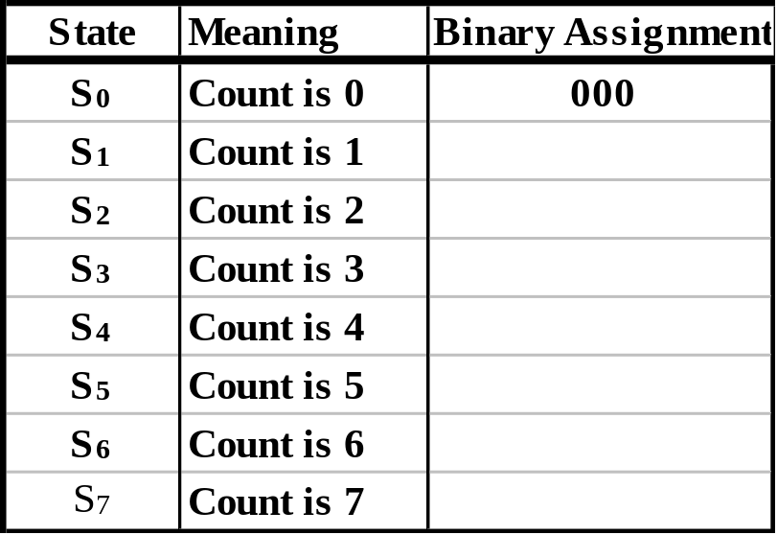
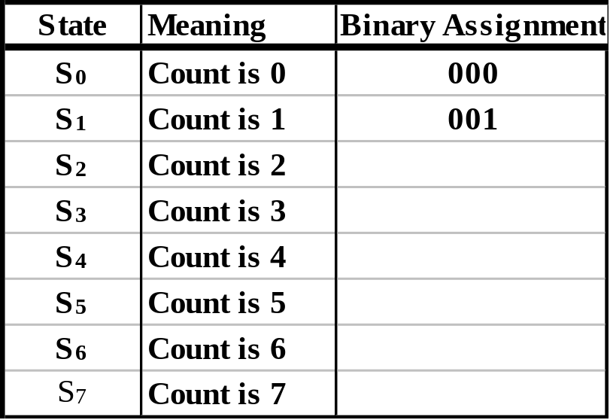
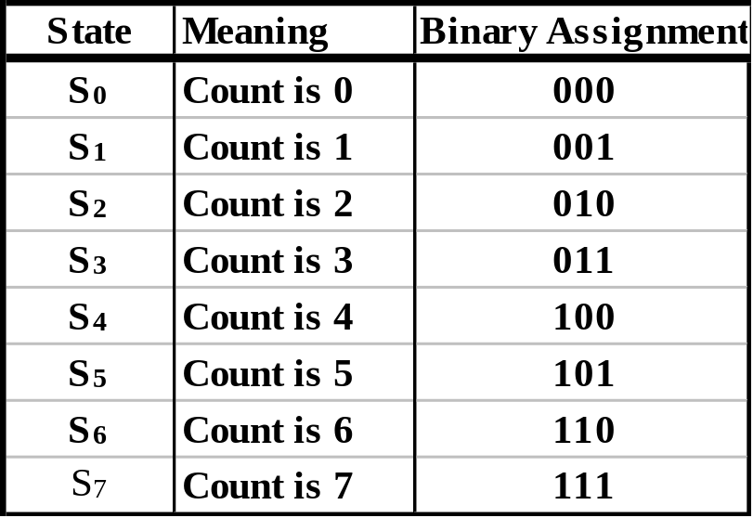
State Machine
EX: Build a 3-bit synchronous binary up/down counter using T flip-flops. Up(Down) when Up/Down =1(0).
State (Transition) Diagram
State Definition Table
1
S₀
S₇
0
1
0
0
1
S₁
S₆
1
0
0
1
S₂
S₅
1
0
0
1
0
S₃
S₄
1

Slide 17
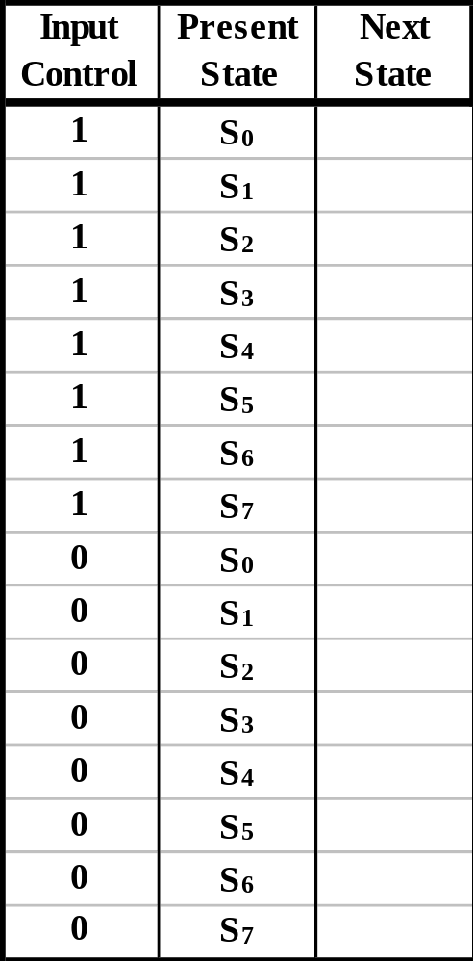
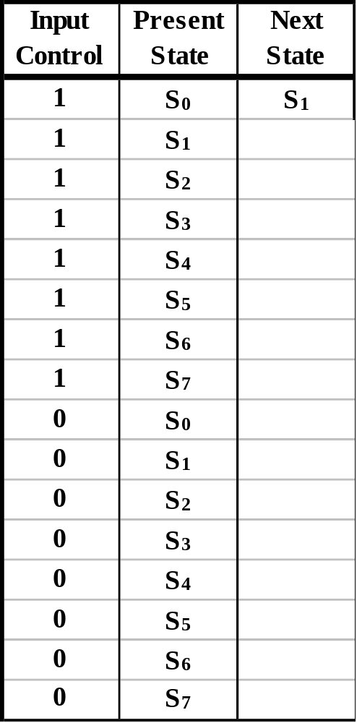
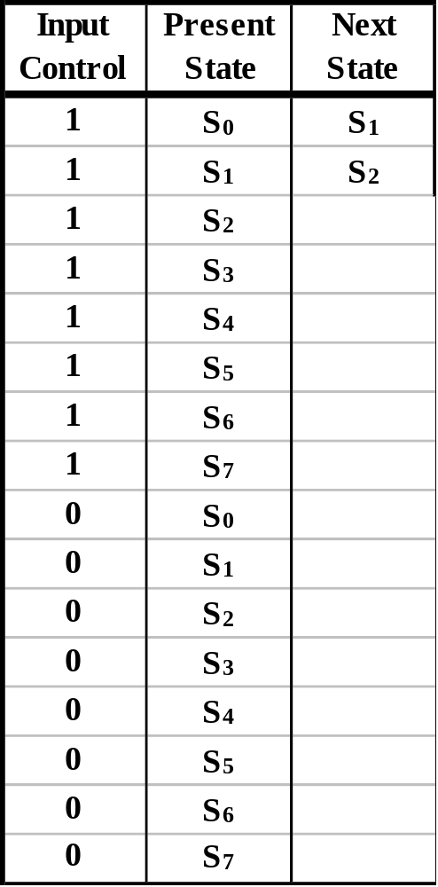
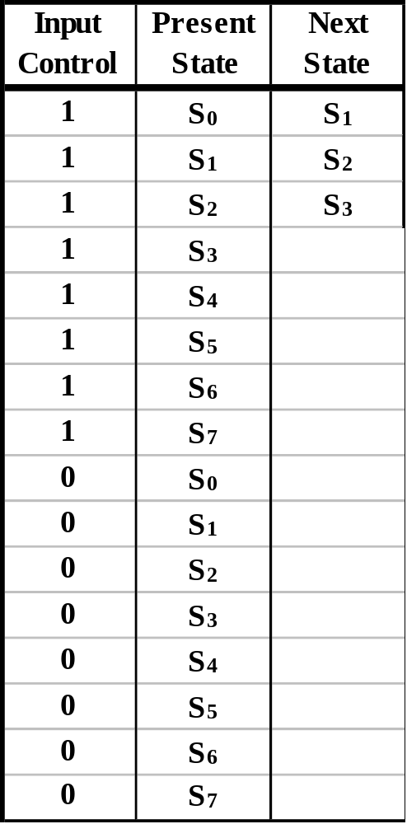
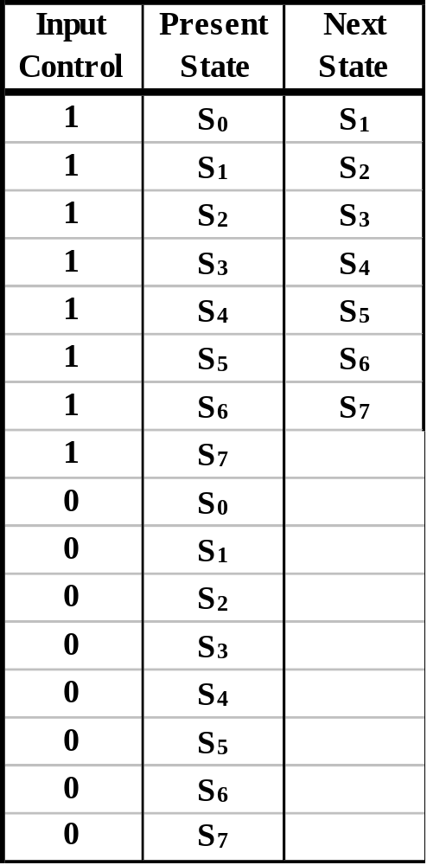
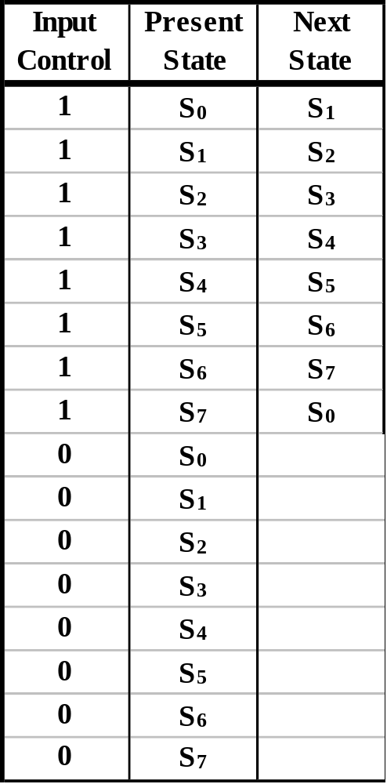
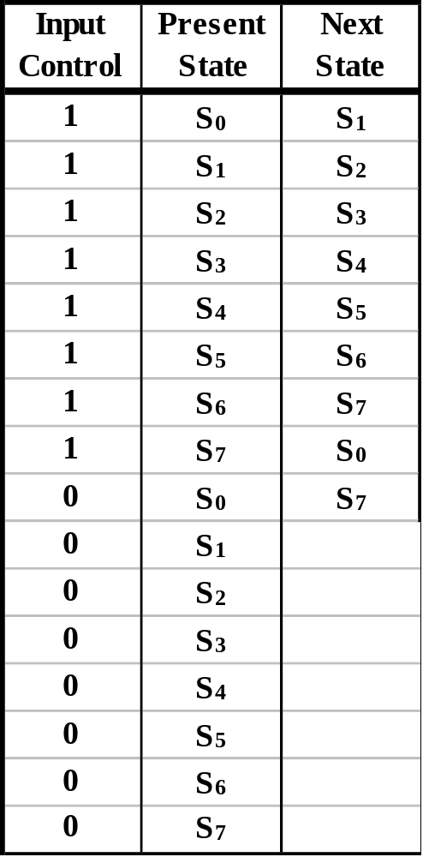
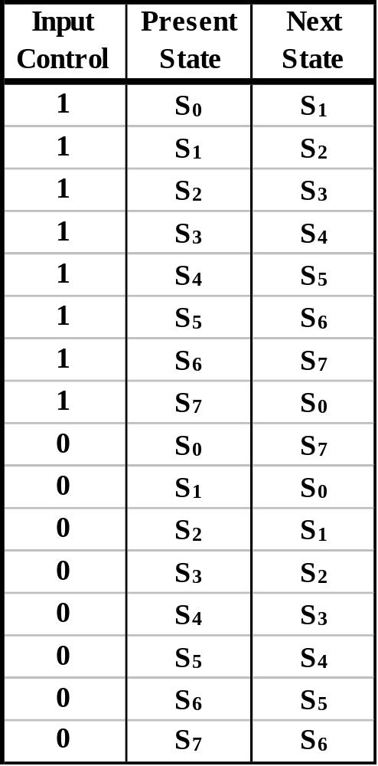
State Machine
Transition Table
  Enter the State Transition Diagram Information into a Transition Table.
State (Transition) Diagram
1
S₀
S₇
0
1
0
0
1
S₁
S₆
1
0
0
1
S₂
S₅
1
0
0
1
0
S₃
S₄
1

Slide 18
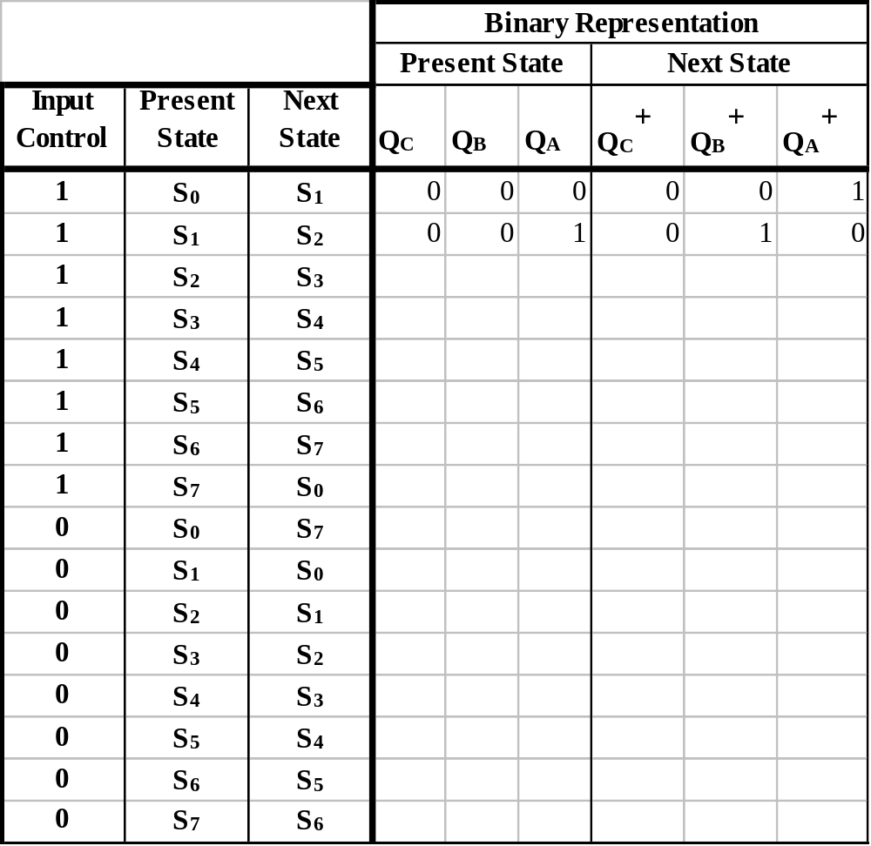
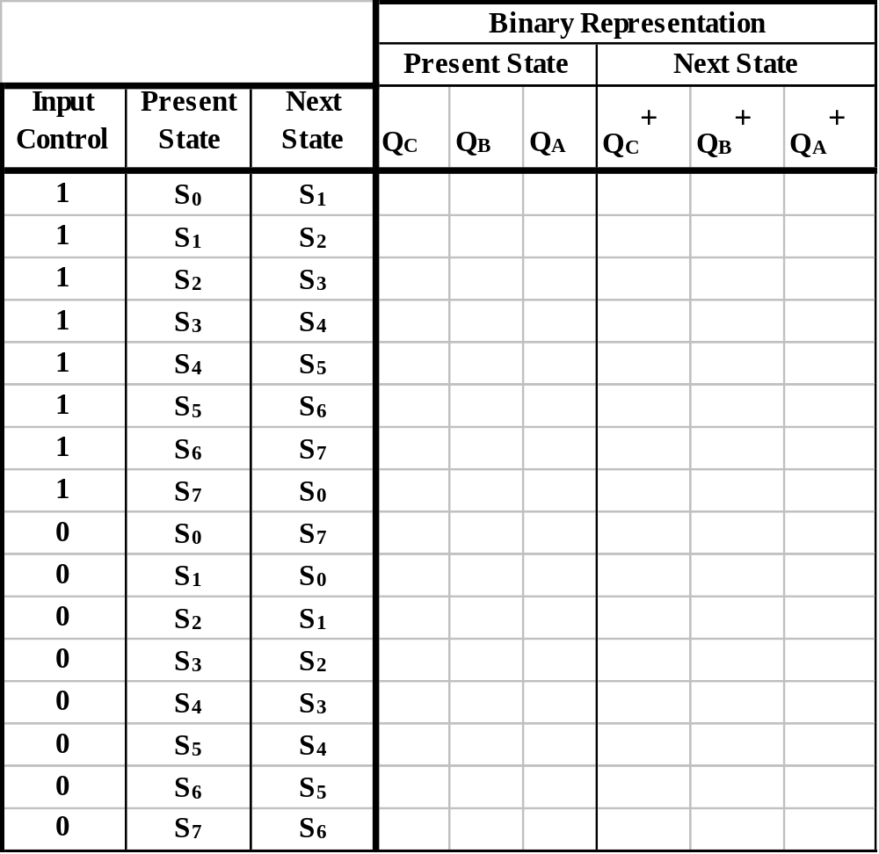
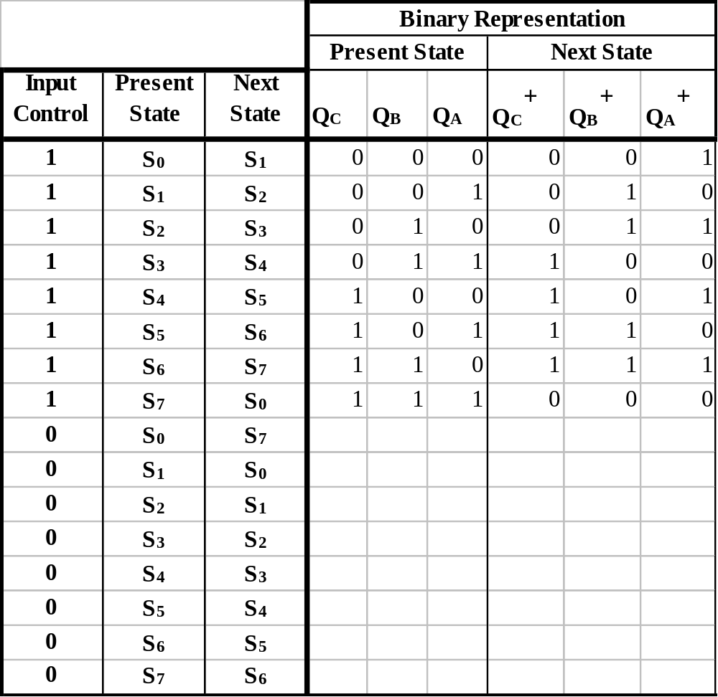
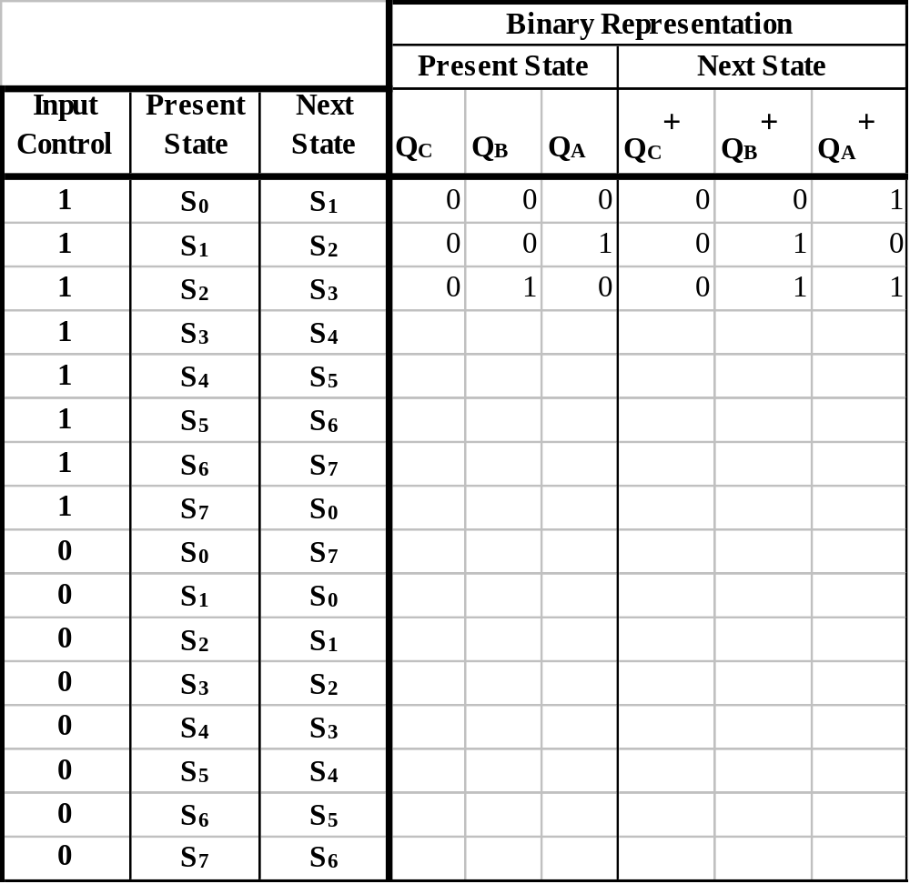

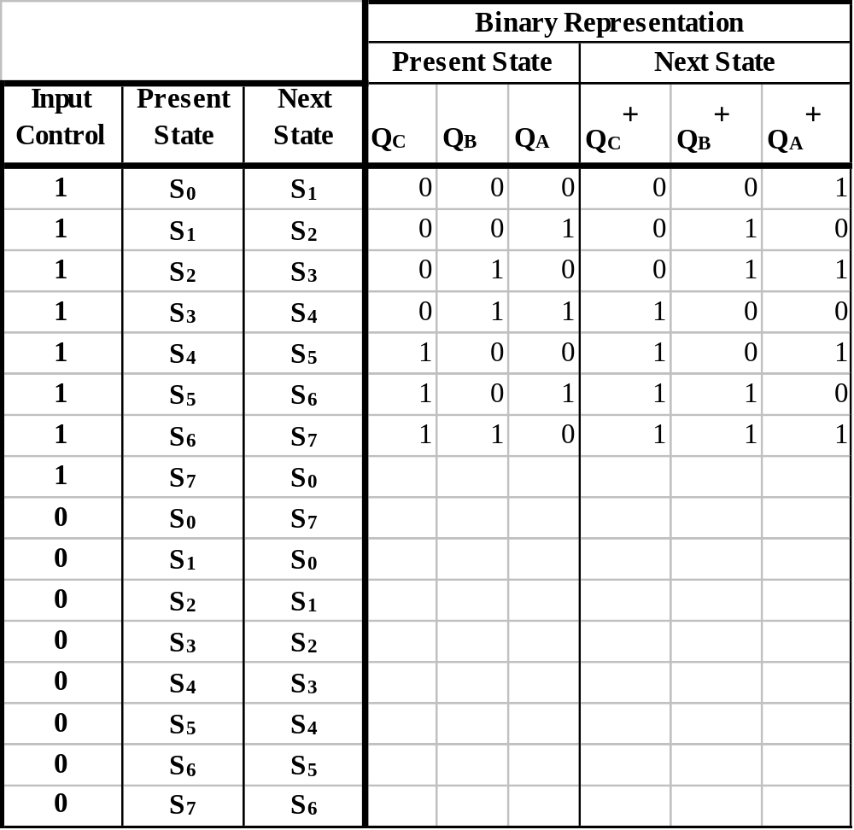
  Fill-in the Transition Table.
INDIVIDUALLY: Fill in the remaining rows of the table.

Slide 19
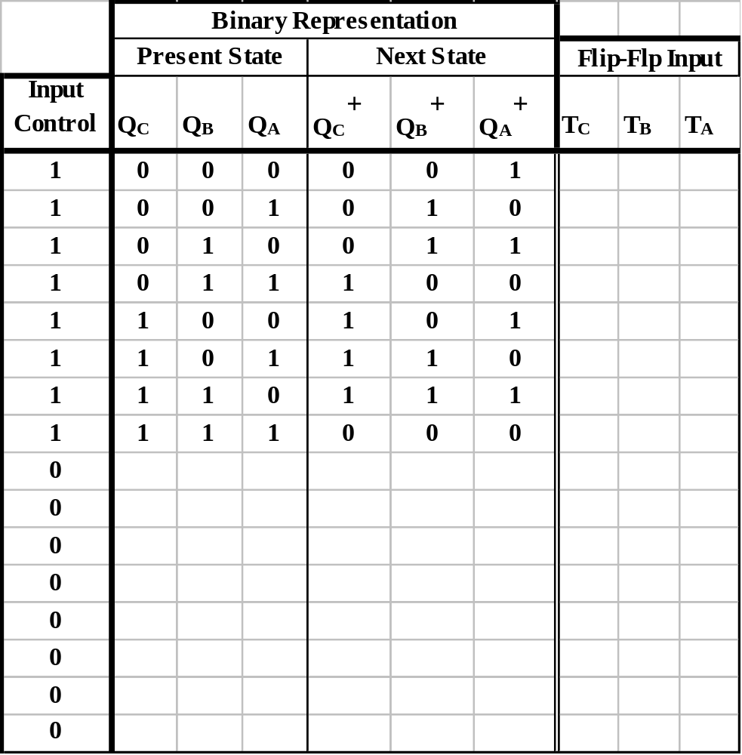
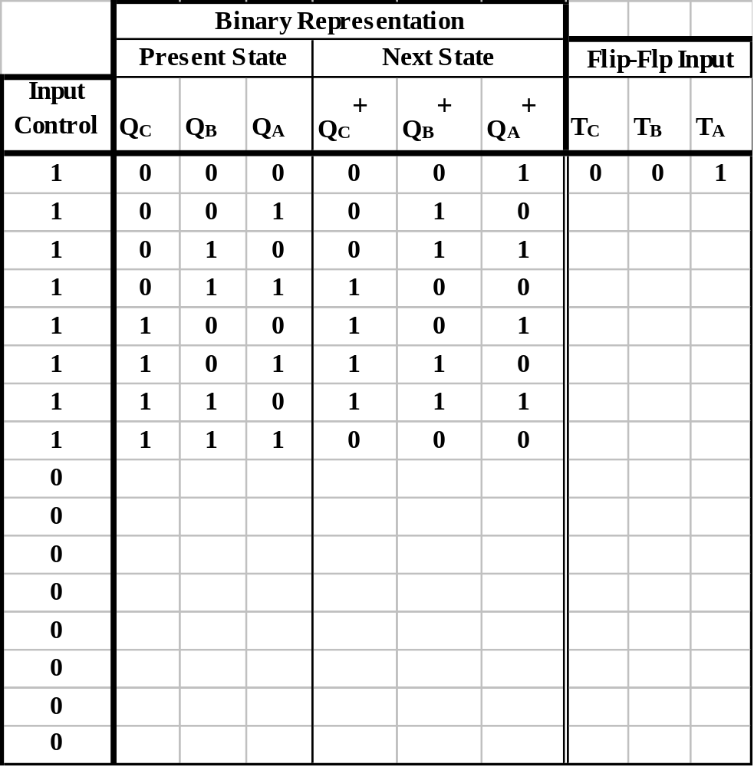
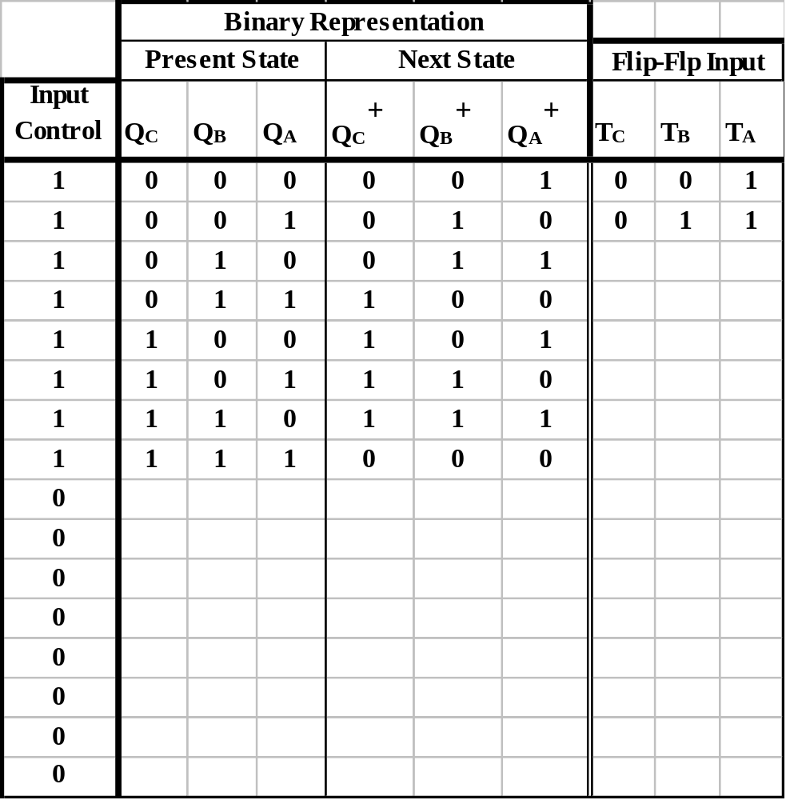
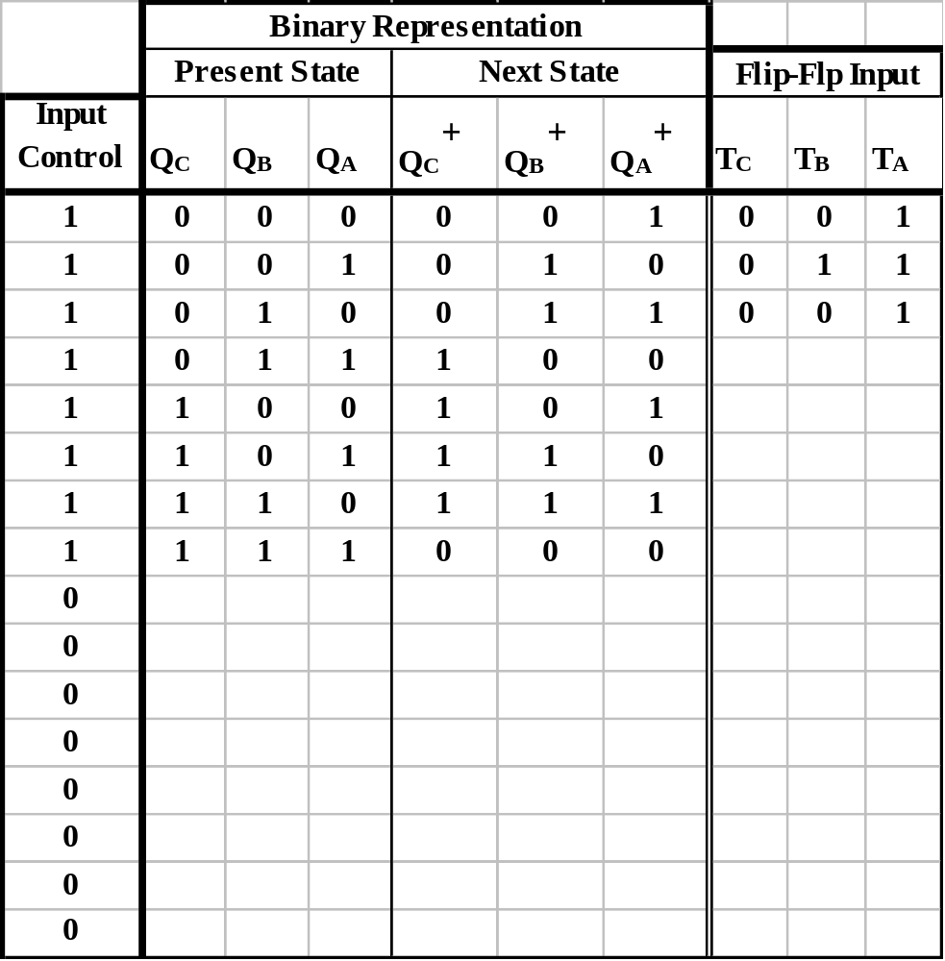
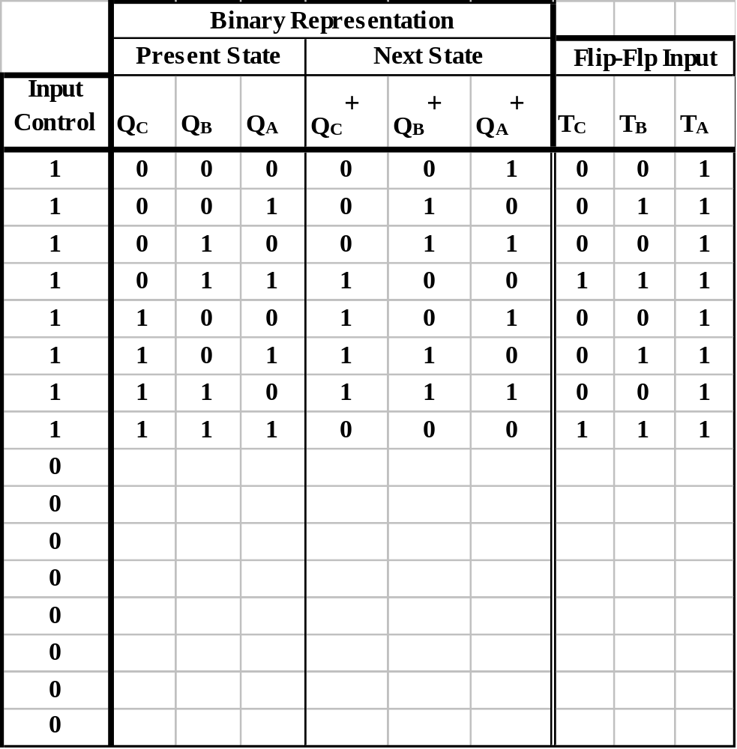
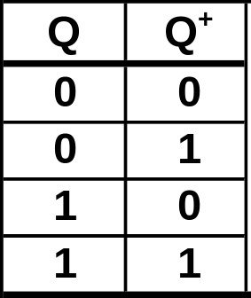

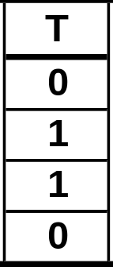
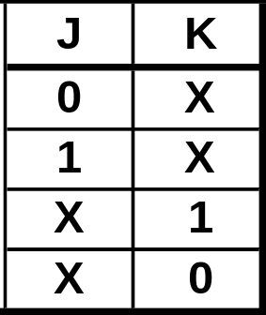

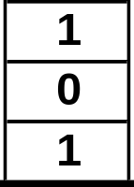
  Complete the Transition Table.
INDIVIDUALLY: Fill in the remaining rows of the table.
Excitation Table.

Slide 20
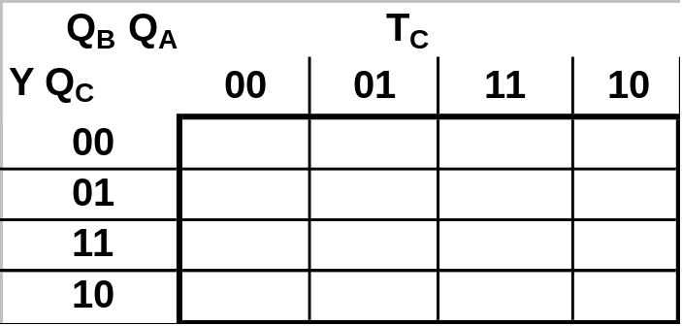
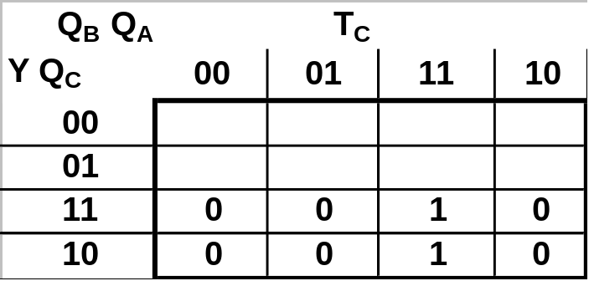
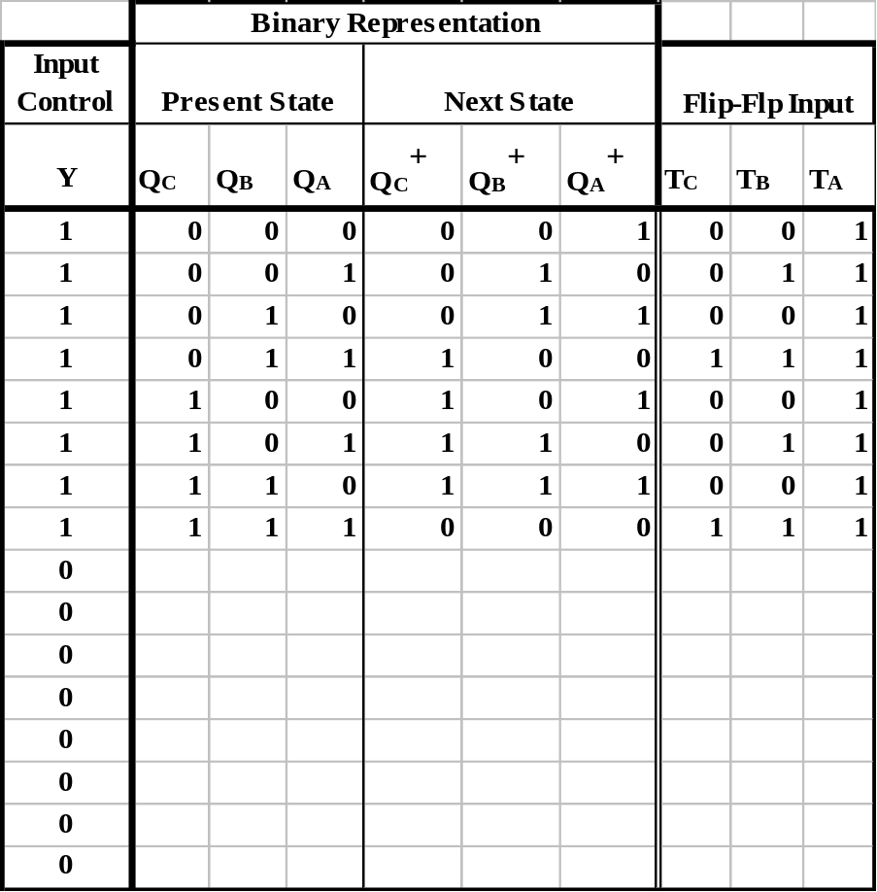
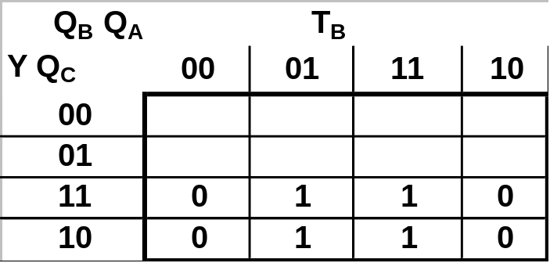
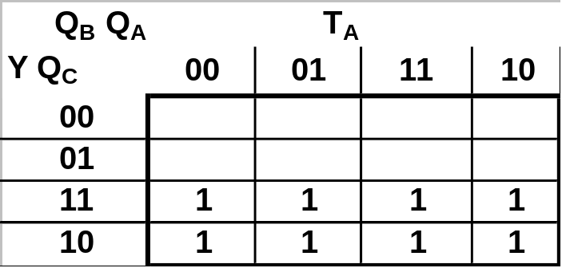
State Machine
Using Karnaugh Maps find the minimum SOP forms for the functions T_{C}, T_{B}, and T_{A}, as functions of Y(Input Control), Q_{C}, Q_{B}, and Q_{A}.
Individually: Complete the Karnaugh maps and find the minimum SOP forms for T_{C}, T_{B}, and T_{A}.

Slide 21
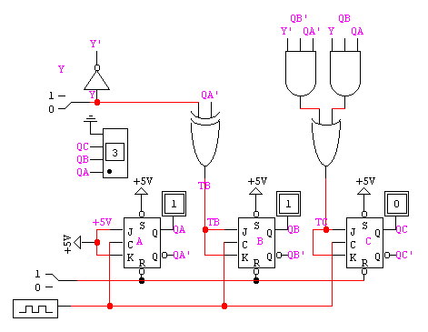
The final design of the circuit is:

Slide 22
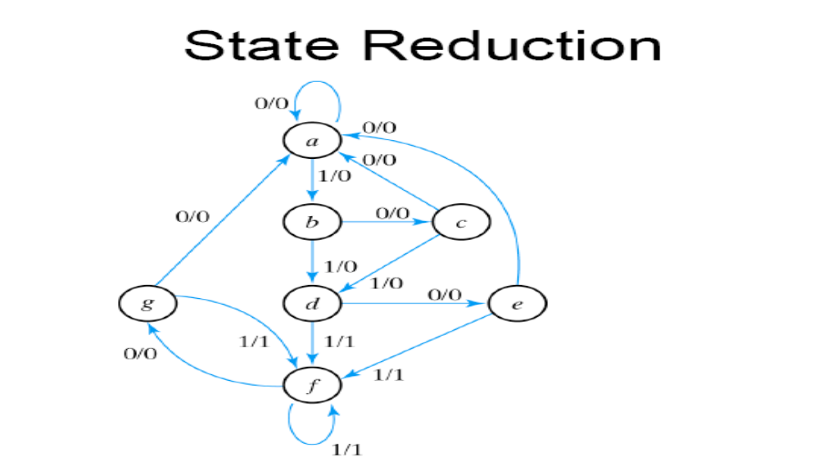
State Reduction

Slide 23
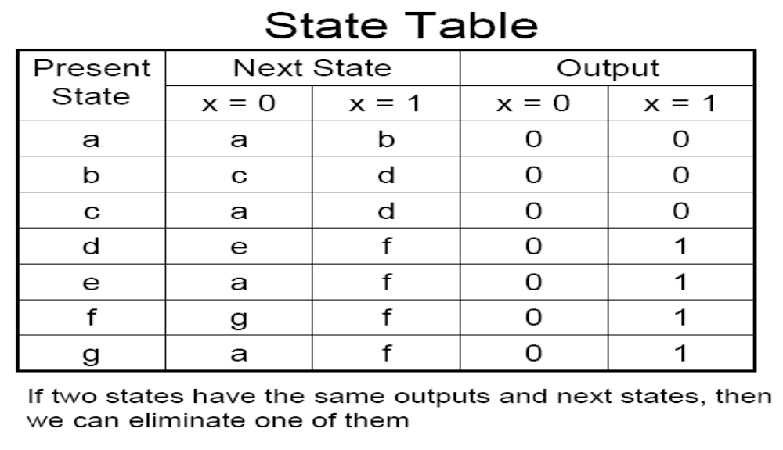
State Reduction

Slide 24
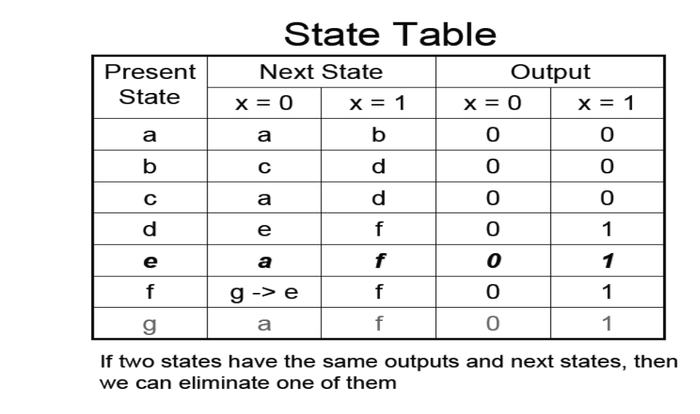
State Reduction

Slide 25
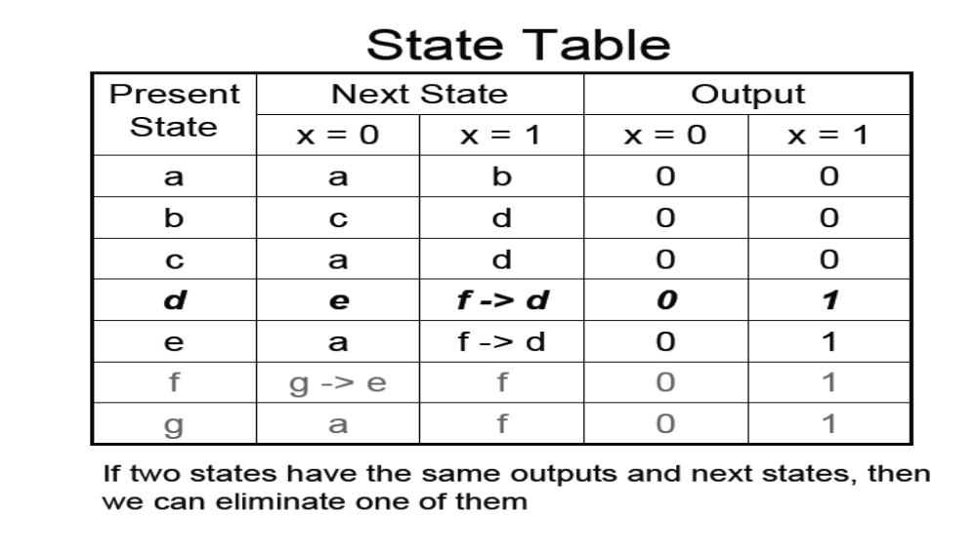
State Reduction

Slide 26
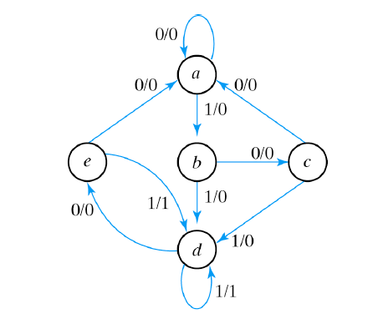
State Reduction

Slide 27
Moore Machine
Most Logic circuits looks like :
Combinational Logic
Input
C.L. Output
Clk
Flip-Flop Array

Slide 28
Moore Machine
Combinational
Logic
Flip-Flop
Array
Combinational
Logic
Input
Output
Clock
The output is a function of the state (combinational logic), independent of the input

Slide 29
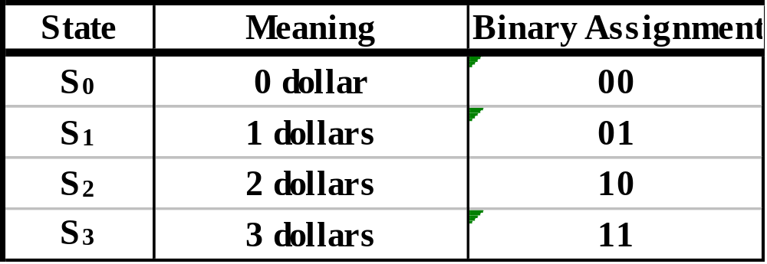
Moore Machine
In a vending machine, where the price of the product is 3 dollars
Reset
(2D,1D)=(0,0)
Slides taken from Prof. Tylavsky, Arizona State University
Any
Input
(2D,1D)=(0,1)
S₀
S₃
Not Open
(1,0)
Open
(0,1)
,(1,0)
(0,0)
S₁
(0,1)
S₂
(1,0)
Not Open
Not Open
(0,0)

Slide 30
Mealy Machine
Combinational
Logic
Flip-Flop
Array
Combinational
Logic
Input
Output
Clock
The output is a function of both the input and the clock. It changes when the INPUT changes! i.e., asynchronously!

Slide 31
Moore and Mealy Machines
Design a Moore & Mealy machine whose output is asserted whenever its input string has 2 1’s in sequence and goes to 0 on a 0 input.
Input Sequence = 0101101110
Output Sequence= 00001001
Key
Pad
Finite State
Synchronous
Machine
Mealy or Moore
0
1

Slide 32
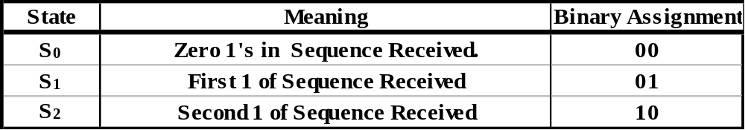
Moore Machine
In a Moore machine, we can’t move from a state to another without a clock edge (+/-)
0
Reset
1
S₀
[0]
1
S₁
[0]
1
S₂
[1]
0
0

Slide 33
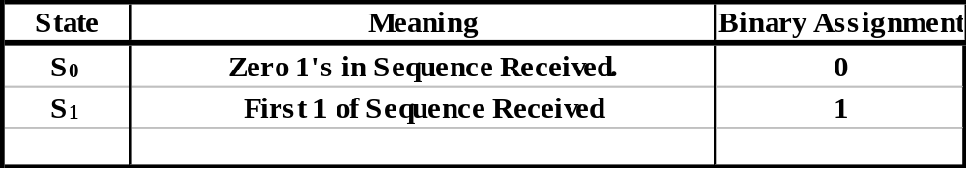
Mealy Machine
A mealy machine is an asynchronous fewer state machine, we CAN move from a state to the other based on the input with a fixed clock
/1
0
1
/0
Reset
/0
S₀
1
S₁
0
/0

Slide 34
Reset
0
Reset
1
/0
/1
0
1
S₀
[0]
1
S₁
[0]
1
S₂
[1]
/0
S₀
1
S₁
0
Mealy
0
/0
Moore
0
Input Seq.
1
0
1
1
0
0
Clk
Y
Moore
State
State S₀
State S₁
State S₀
State S₁
State S₂
State S₀
Moore
Output
Mealy
State
State S₀
State S₁
State S₀
State S₁
State S₁
State S₀
Mealy
Output
Valid Mealy Output
{
{
Valid Mealy Output

Slide 35
Synchronous Mealy Machine
It is possible to synchronize a mealy machine, but with more flip flops.
Combinational
Logic
Flip-Flop
Array
Combinational
Logic
Input
Output
Clock
Flip-Flop
Array
Output

Slide 36
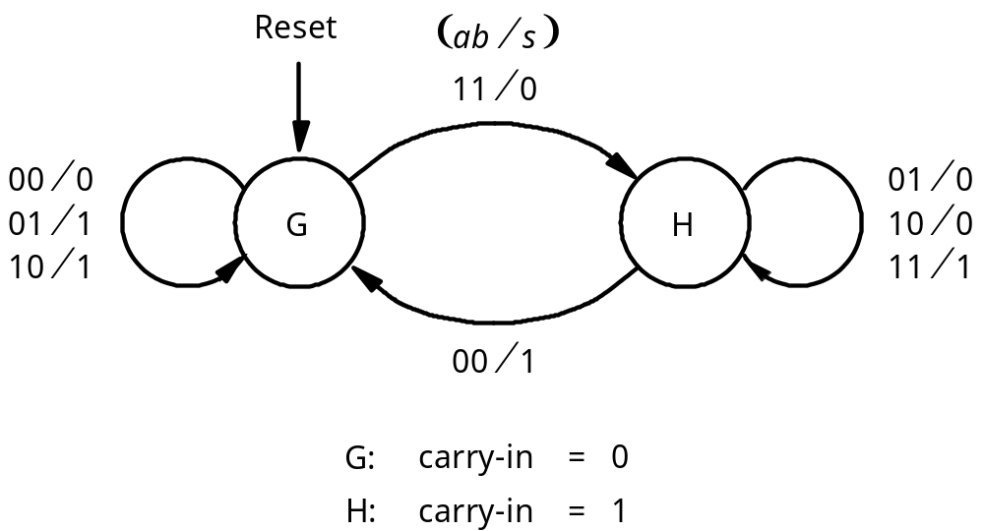
Mealy Machine

Slide 37
Mealy Machine
Present
Next state
Output
s
state
ab
=00
01
10
11
00
01
10
11
G
G
G
G
H
0
1
1
0
H
G
H
H
H
1
0
0
1

Slide 38
Moore Machine
Sum bit
Y
1
y
1
a
D
Q
s
b
Full
adder
Carry-out
Q
Y
2
y
2
D
Q
Clock
Q
Reset

Slide 39
Moore Machine
Present
Nextstate
Output
state
ab
=00
01
10
11
s
G
0
G
0
G
1
G
1
H
0
0
G
1
G
0
G
1
G
1
H
0
1
H
0
G
1
H
0
H
0
H
1
0
H
1
G
1
H
0
H
0
H
1
1

Slide 40
Moore Machine
Reset
⁄
11
⁄
01
00
G
0
s
=
0
H
0
s
=
0
10
00
01
00
11
01
10
11
10
01
G
⁄
s
=
1
H
⁄
s
=
1
11
10
1
00
1

Slide 41
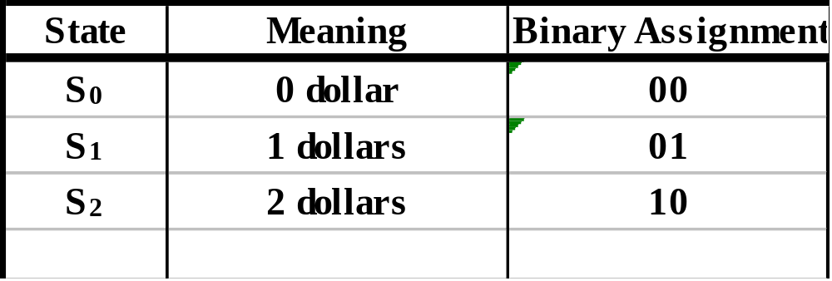
Vending Machine for Mealy
Reset
0/0
0/0
S₀
1/0
S₁
1/1
S₂
1/0
Mealy
0/0

